Slide 1

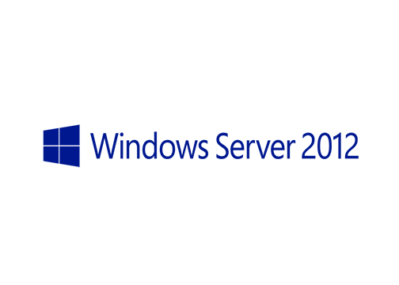
MegaSeries
Install First Windows Server 2012 Domain Controller

Slide 2
Steps
Install a new Windows Server 2012 machine
Set name, network and firewall settings
Promote server to domain controller

Slide 3
https://www.youtube.com/channel/UCcZ-jLbPwNr8E_v9-65n8Iw https://github.com/itknowledge4

